Slide 1
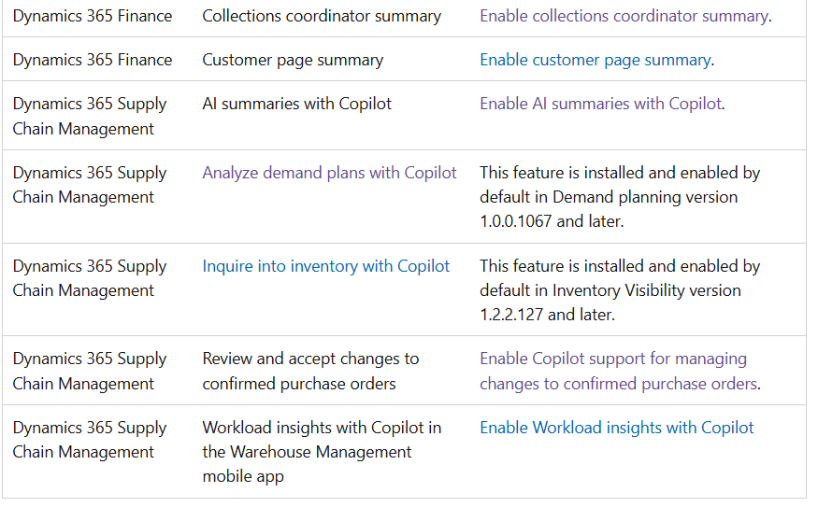
Copilot in Finance and Operations Apps
Enable Copilot capabilities in finance and operations apps - Finance & Operations | Dynamics 365 | Microsoft Learn

Slide 2
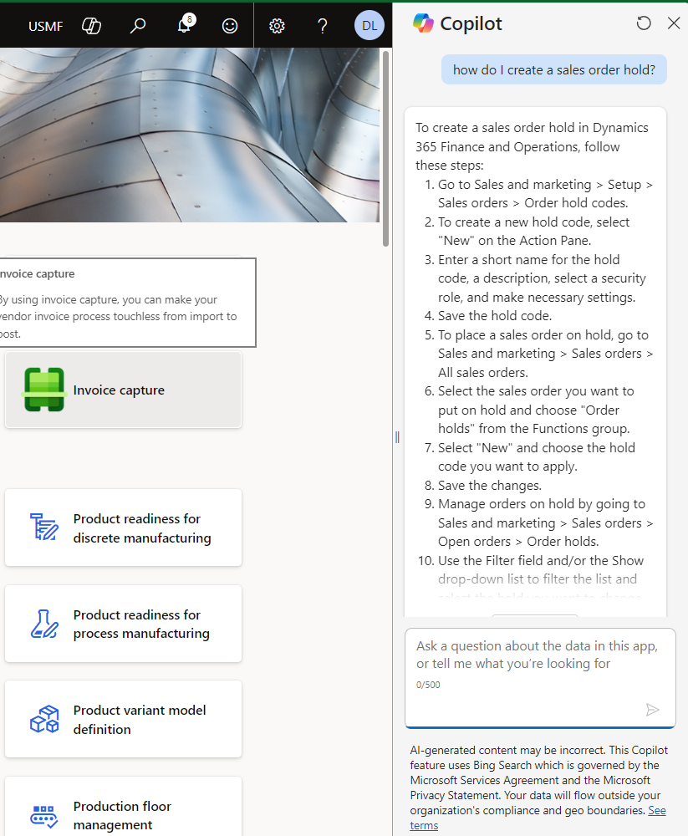
Generative Help & Guidance
Generative help and guidance with Copilot - Finance & Operations | Dynamics 365 | Microsoft Learn
Query rewrite – Copilot reformulates the initial question to optimize understanding and search efficacy.
Document search – Copilot uses the Bing search index to find the most relevant documents in the learn.microsoft.com domain.
Response generation – After it has the relevant documentation, Copilot uses a large language model to construct a comprehensive answer that includes citations from the source material.

Slide 3
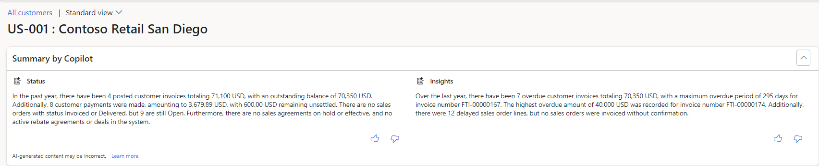
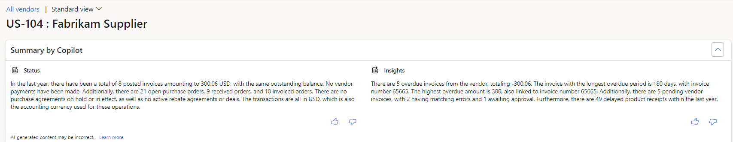
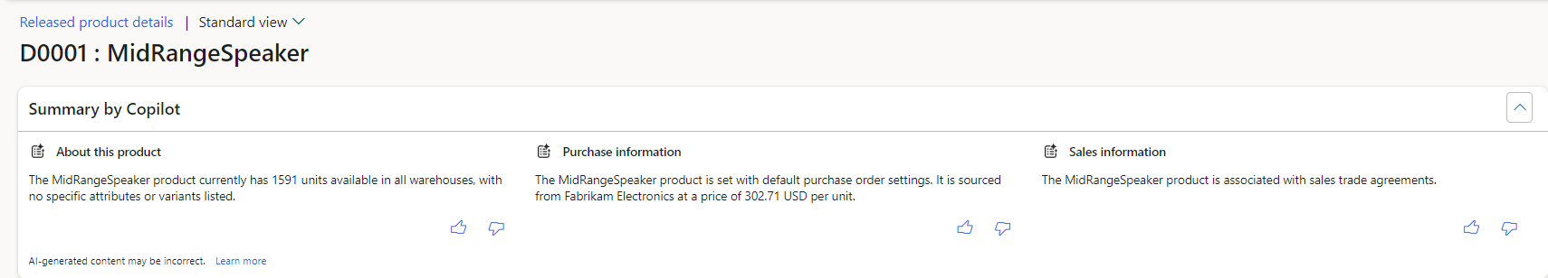
Copilot Summaries

Slide 4
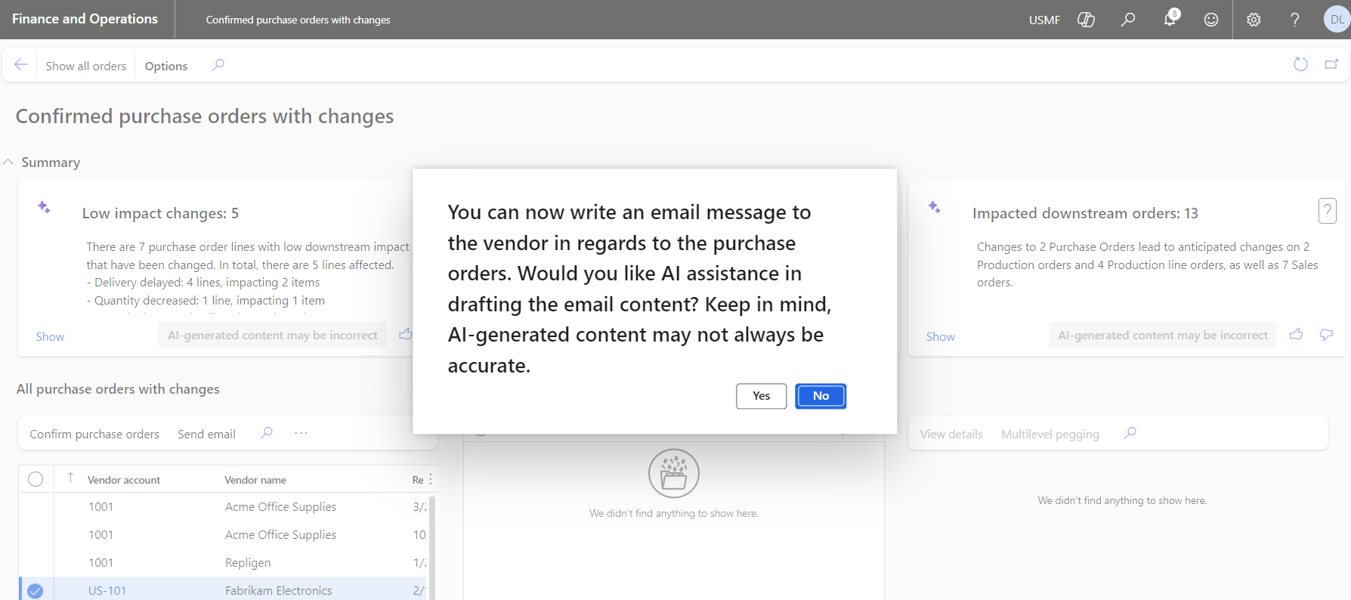
Workspaces

